Slide 1
Name:- Yash Rajendra Gaikwad
Data Analytics Trainee
Project 4:- Hiring Process Analytics.
Software Used:- Microsoft Excel.
Analysis done on following Points:-
A. Hiring:- Process of intaking of people into an organization for different kinds of positions.
Your Task:- How manny males and femails are Hired ?
B. Average Salary:- Adding all the salaries for a selected group of employees and then dividing the sumby the number of employees in the group.
Your Task:- What is the average salary offeredin this company ?
C. Class Intervals:- The class interval is the difference between upper class limit and the lower class limit.
Your Task:- Draw the class intervalsnfor salary in the company ?
D. Charts and Plots:- This is one of the best part of the analysis to visualize the data.
Your Task:- Draw Pie Chart/Bar Graph (or any other graph) to show proportion of people working different department?
E. Charts:- Use different charts and graphs to perform the task representing the data.
Your Task:- Represent different post tiers using charts/graph.

Slide 2
A. Hiring:- Process of intaking of people into an organization for different kinds of positions.
Your Task:- How manny males and females are Hired ?
Process:-
First, we use the COUNTIFS function to calculate to calculate the number of male and females hired in the company.
Select the countifs function from formula box OR just type =COUNTIFS(G:G) then specify the criteria1 as Male and criteria2 as Hired.
Repet the countifs function and specify the criteria1 as Female and criteria2 as Hired.
After that we use the bar chart to visualize gender and the number of males and females hired.

Slide 3
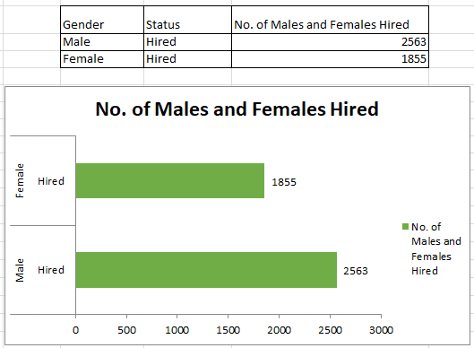
Result:-

Slide 4
B. Average Salary:- Adding all the salaries for a selected group of employees and then dividing the sumby the number of employees in the group.
Your Task:- What is the average salary offeredin this company ?
Process :-
First, we remove the the outliners that i.e. to remove the salaries below 1000 and remove the salaries above 100000.
Then we use the formula of Average and select the entire colume of the salary after removing outliners.
Formula Used:-
= AVERAGE (G:G)
Result:- The Average salary offered in the company is 49983.03223.

Slide 5
C. Class Intervals:- The class interval is the difference between upper class limit and the lower class limit.
Your Task:- Draw the class intervalsnfor salary in the company ?
Process:-
To find the solution of this task first we need to select all the data and use the Pivot Table function.
In pivot table field list box, we place the Status in the Report filter.
In the Row Lables we add the Department and in the Values we add offered salary.
We use the Average Offered salary from the value field setting.
Finally we use the column chart to represent the data.

Slide 6
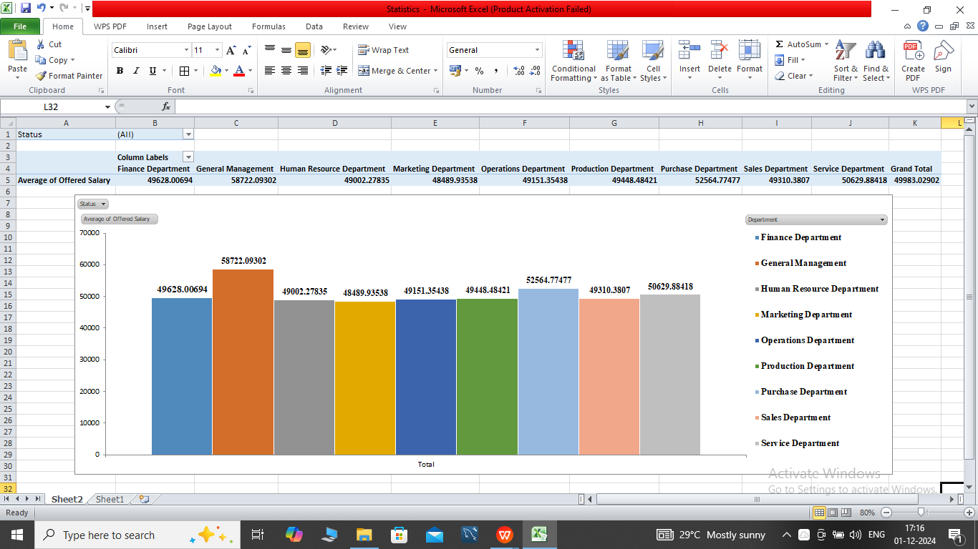
Result:-

Slide 7
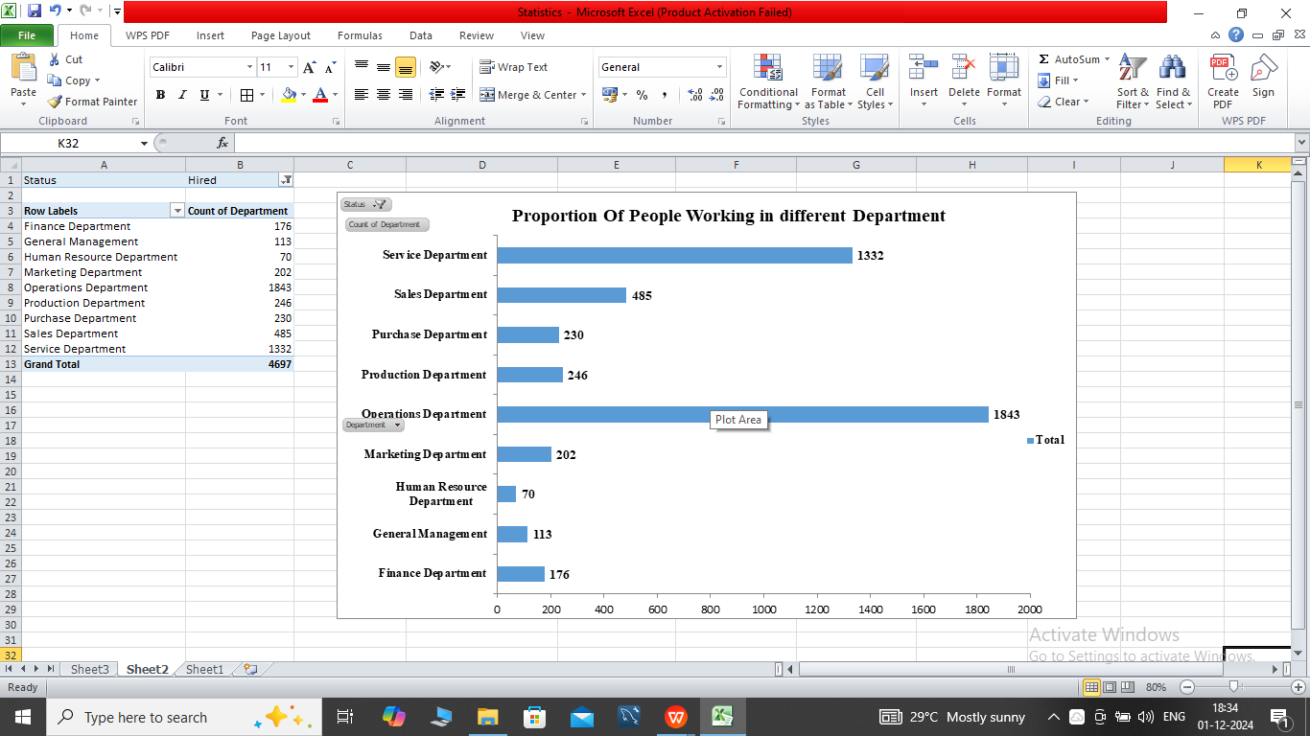
D. Charts and Plots:- This is one of the best part of the analysis to visualize the data.
Your Task:- Draw Pie Chart/Bar Graph (or any other graph) to show proportion of people working different department?
Process:-
We use the Pivot Table function for this task.
Add the Status in the Report Filter and Department field in the Axis field.
Also add the Offered Salary in Value and use count offered salary from value field setting.
Now, for visulization first we use the Bar chart. before that select the Hired from the Status.

Slide 8
Result:-

Slide 9
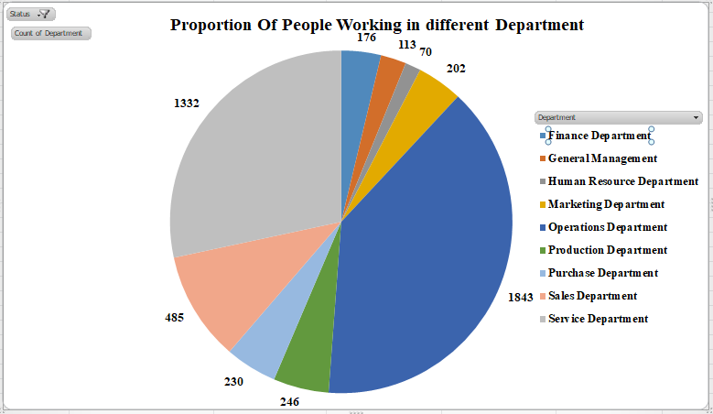
Result:-

Slide 10
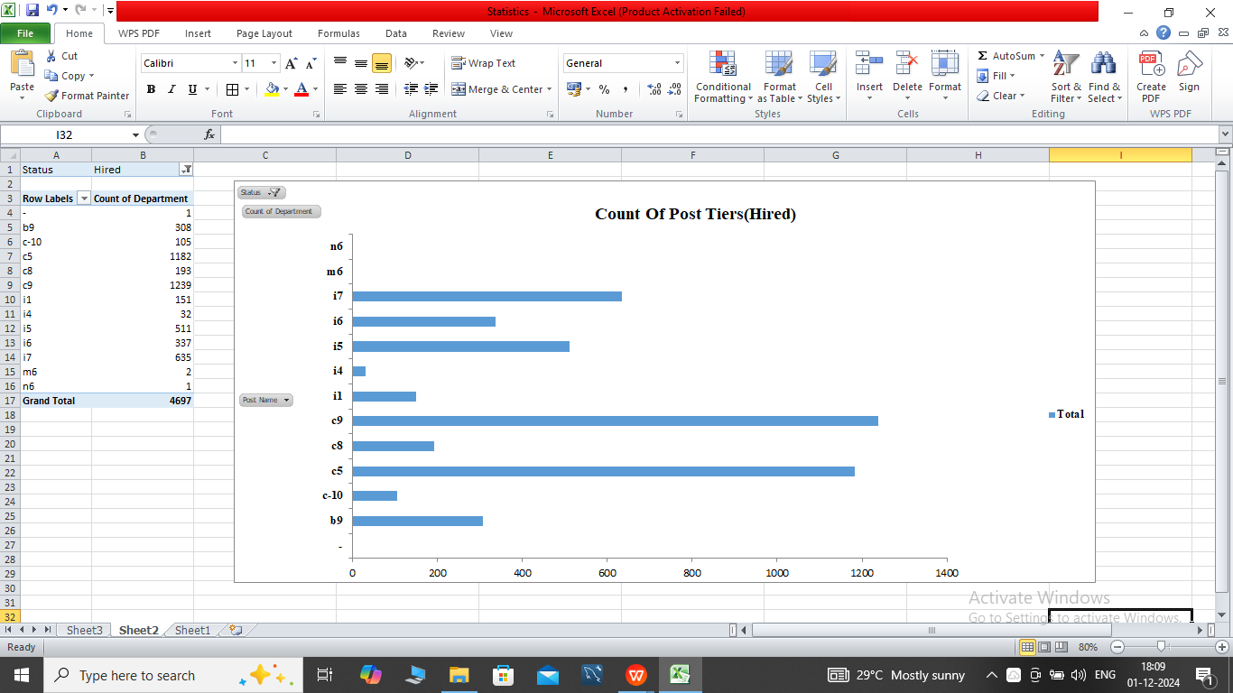
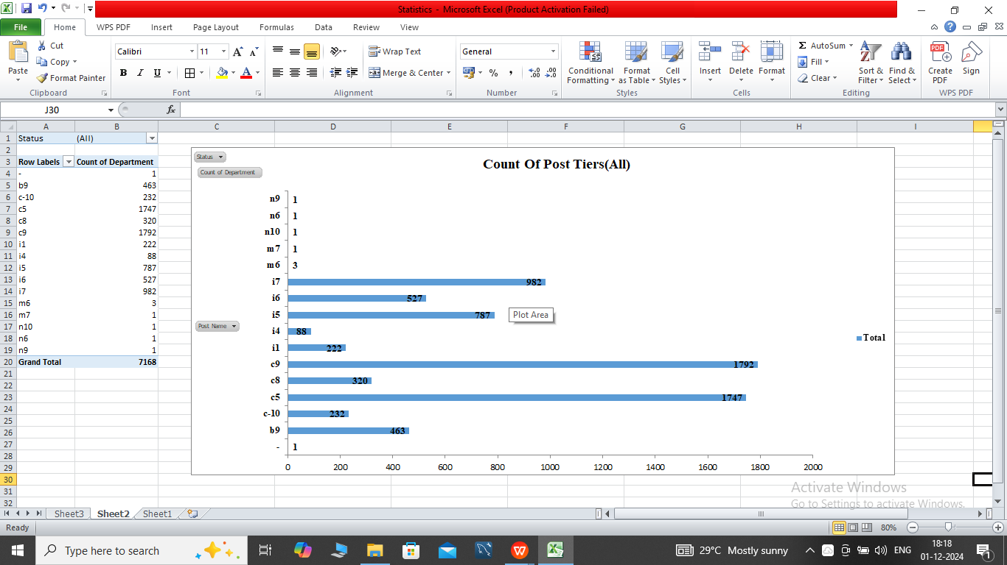
E. Charts:- Use different charts and graphs to perform the task representing the data.
Your Task:- Represent different post tiers using charts/graph.
Process:-
We use the Pivot Table function.
Drag Status in Report filter and Post Name in Row Lables.
Adding Department in values use Count of department from value field setting.
We use the 2 cases first the Hired peoples and the second for the all the peoples (hire and not hired).
Finally, we use the Bar chart and Pie chart for the both cases.

Slide 11
Result:-

Slide 12
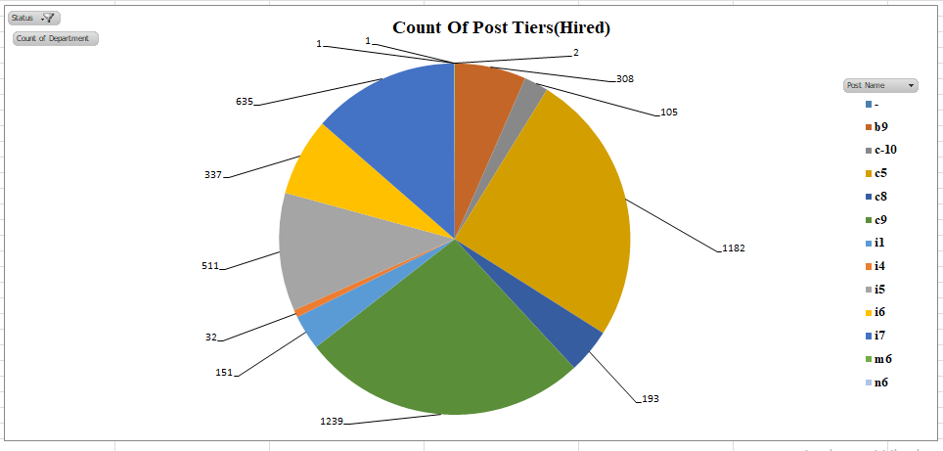
Result:-

Slide 13
Result:-

Slide 14
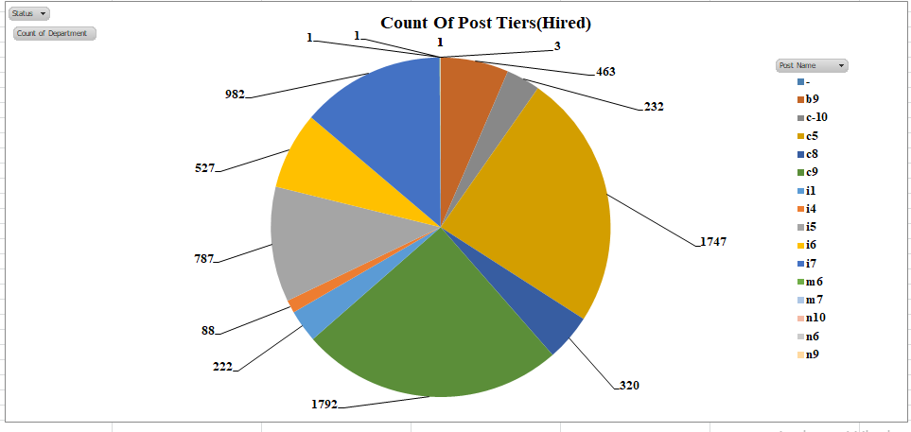
Result:-

Slide 15
END

